Slide 1
How to securely implement MCP with OAuth in .NET

Slide 2

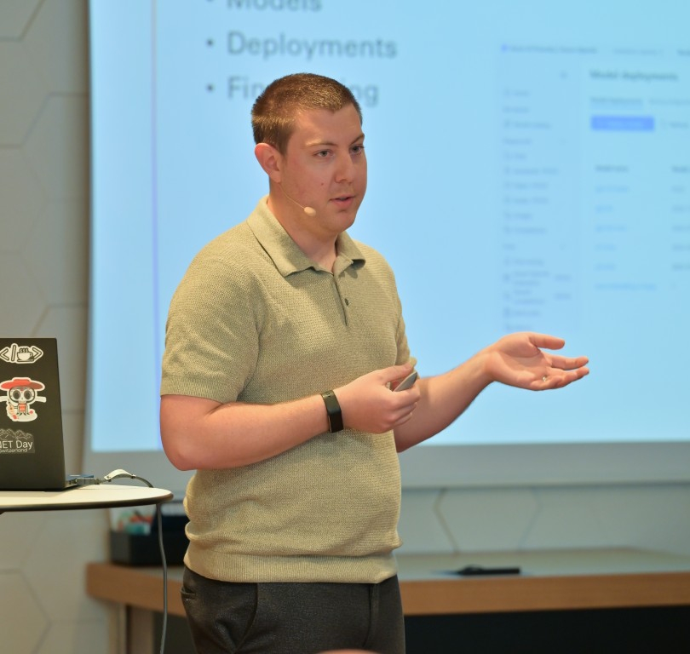





cÉdric Mendelin
Damien Bowden
Software Developer - isolutions AG
Software Developer - isolutions AG

Slide 3
Agenda
Getting started with MCP in dotnet
How to make it secure
Demo
Conclusion

Slide 4
Getting started

Slide 5
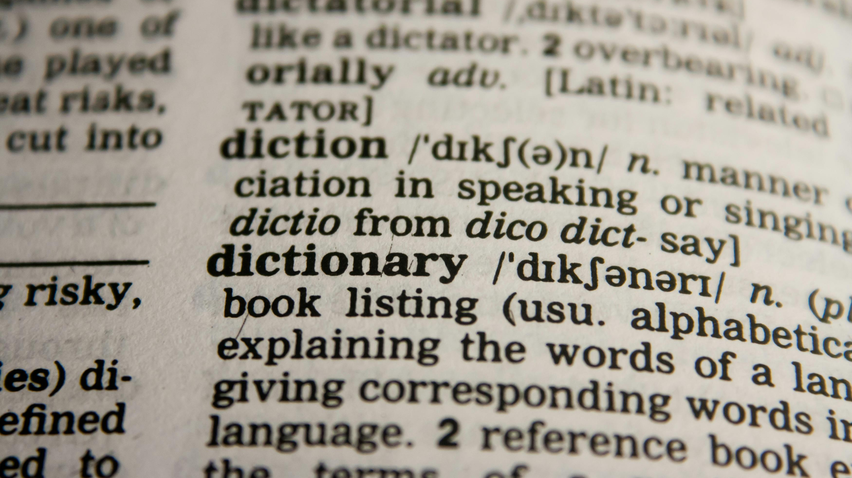

Slide 6
What is the current date?

Slide 7


Slide 8


Slide 9
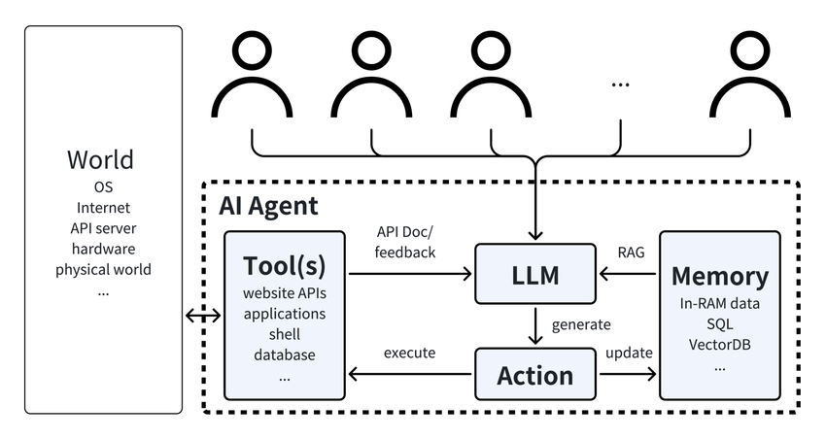
LLM Based AI Agent
Security of AI Agents, He et al. 2024 https://arxiv.org/pdf/2406.08689

Slide 10

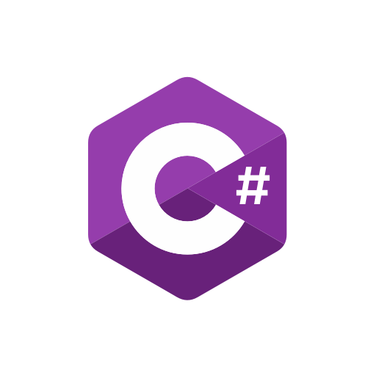
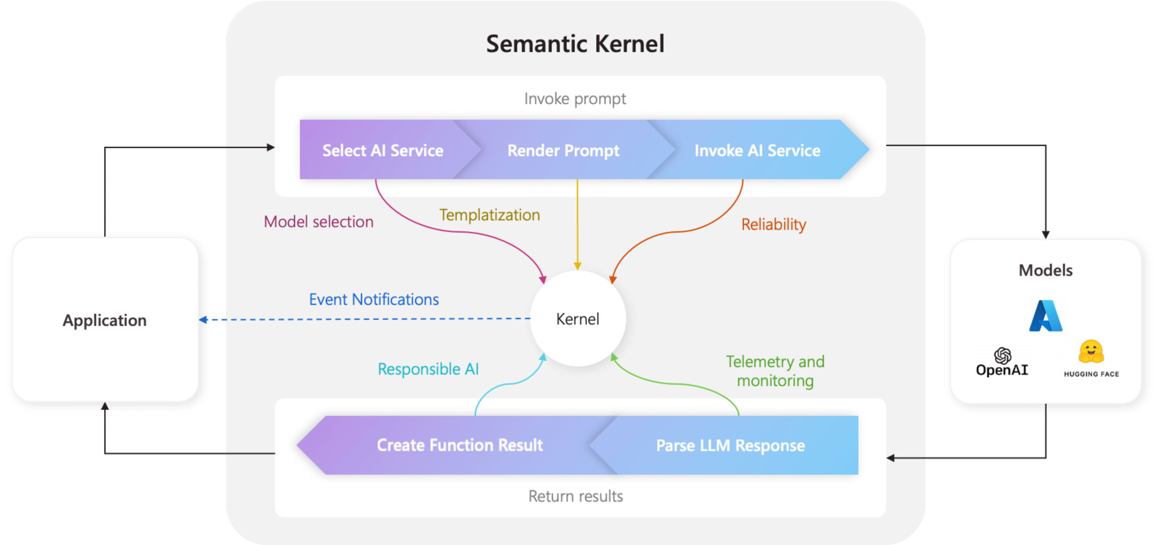

Slide 11
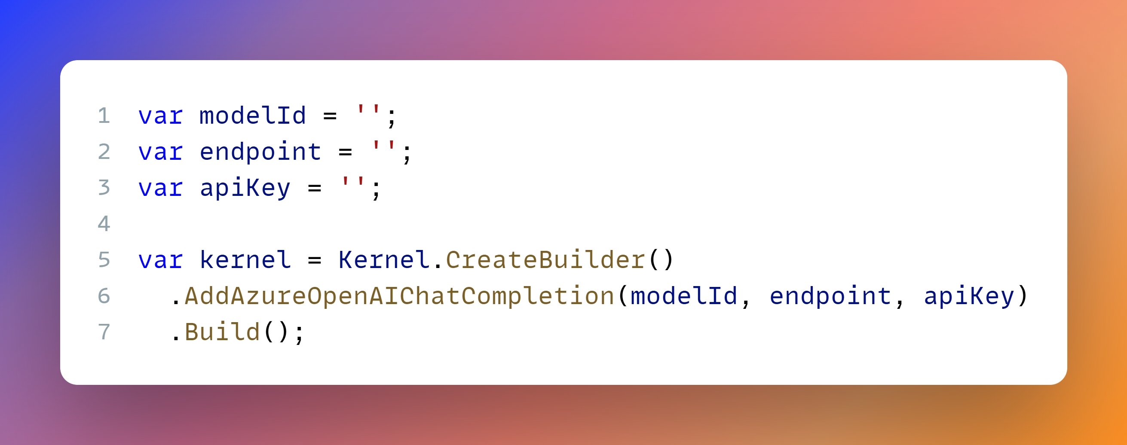
SK – Setup

Slide 12
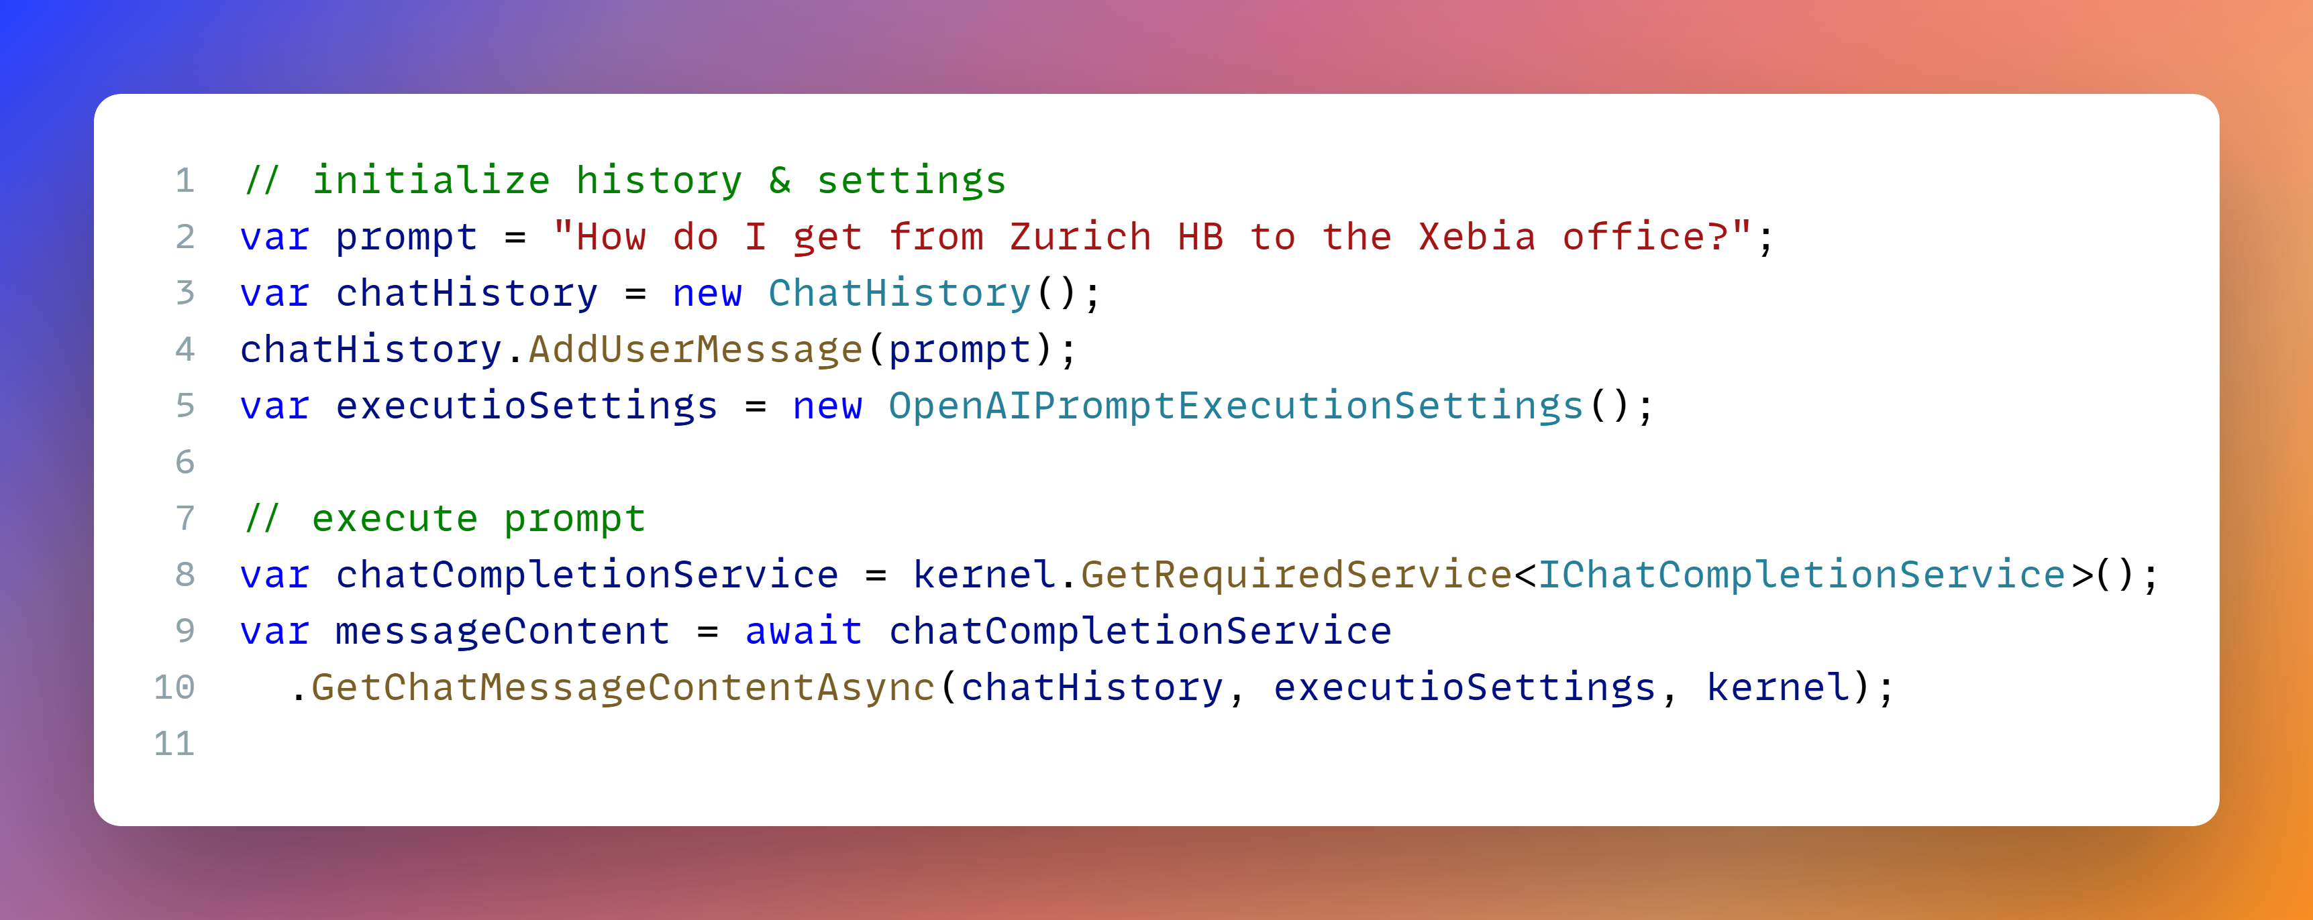
SK – execute prompt
Notes:
// initialize history & settings
var prompt = "How do I get from Zurich HB to the Xebia office?";
var chatHistory = new ChatHistory();
chatHistory.AddUserMessage(prompt);
var executioSettings = new OpenAIPromptExecutionSettings();
// execute prompt
var chatCompletionService = kernel.GetRequiredService<IChatCompletionService>();
var messageContent = await chatCompletionService
.GetChatMessageContentAsync(chatHistory, executioSettings, kernel);

Slide 13
What is the current date?

Slide 14
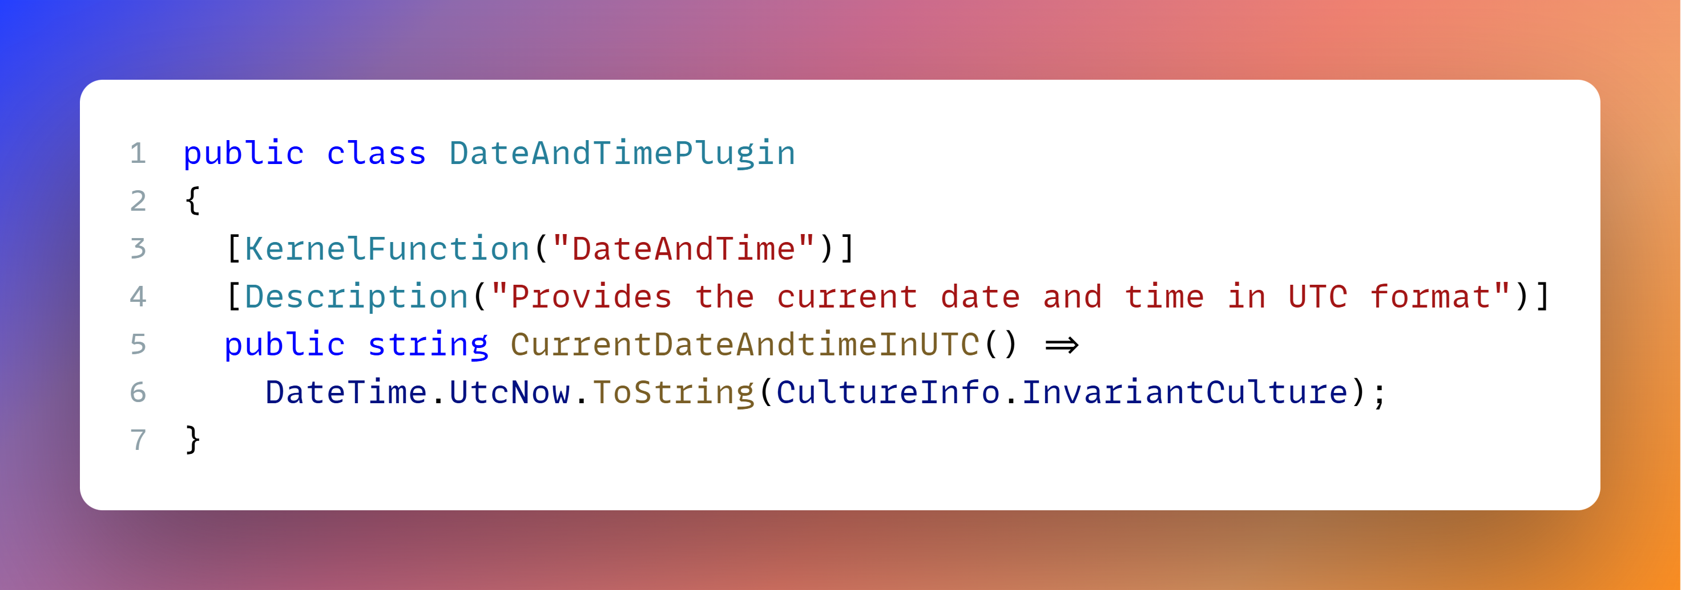
Sk – Plugin
Notes:
public class DateAndTimePlugin
{
[KernelFunction("DateAndTime")]
[Description("Provides the current date and time in UTC format")]
public string CurrentDateAndtimeInUTC() =>
DateTime.UtcNow.ToString(CultureInfo.InvariantCulture);
}

Slide 15
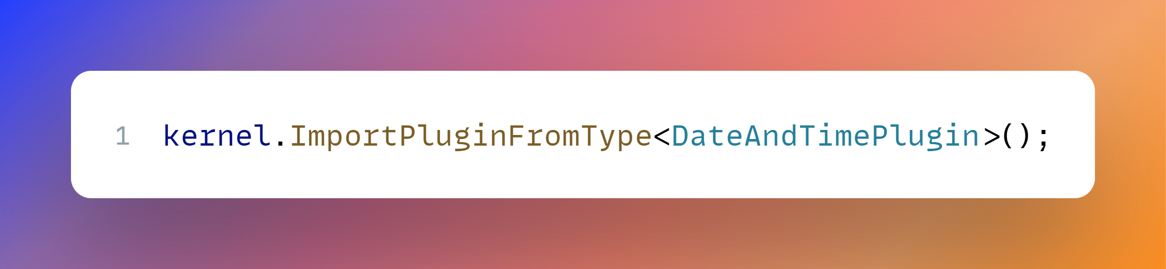
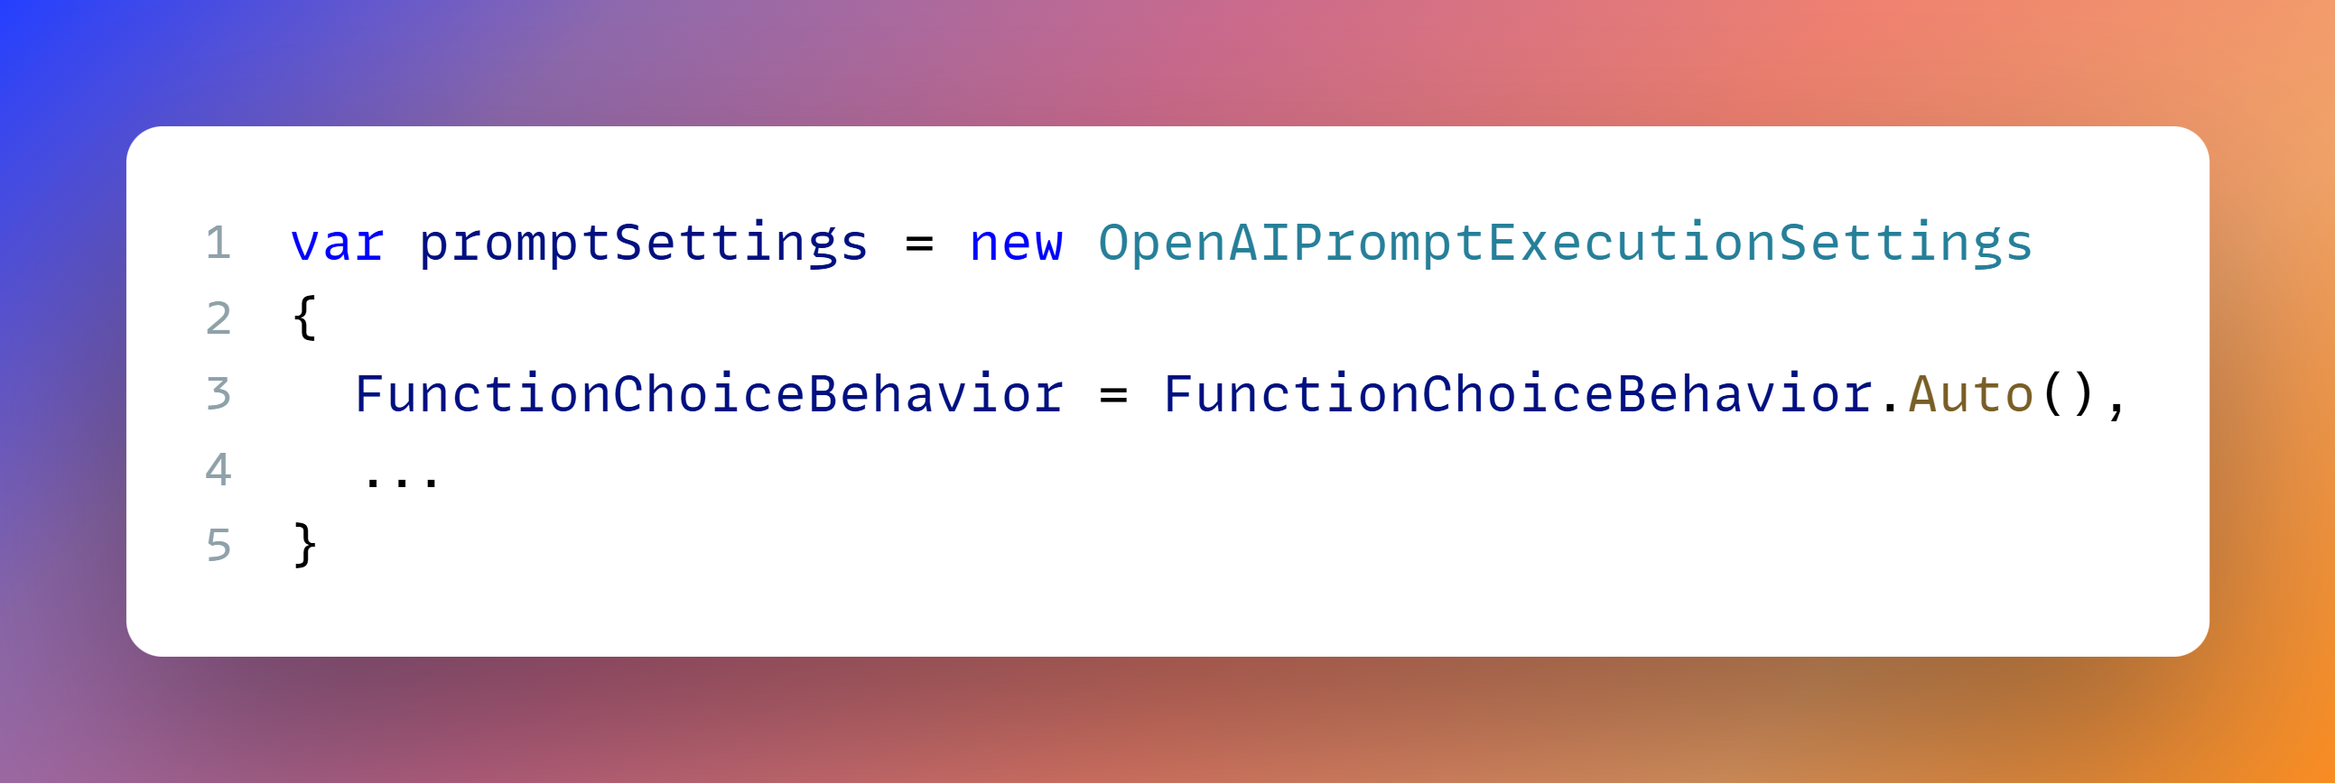
Sk – Plugin
Notes:
kernel.ImportPluginFromType<DateAndTimePlugin>();
var promptSettings = new OpenAIPromptExecutionSettings
{
FunctionChoiceBehavior = FunctionChoiceBehavior.Auto(),
...
}

Slide 16
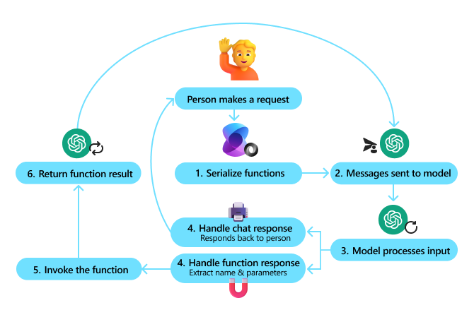
Function CAlling

Slide 17




Model context protocol (MCP)
Client – Server
Transport
Stdio (local)
Http (remotely)
Server-Sent Events for Streaming
JSON-RPC
MCP Host (AI Agent)
MCP Client 1
MCP Client 2
…
MCP Client N
One-to-one
connection
One-to-one
connection
One-to-one
connection
MCP Server 1
MCP Server 2
…
MCP Server N

Slide 18
MCP Capabilities
MCP Server
Tools
Resources
Prompts
Utilities
Completion
Logging
Pagination
MCP Client
Roots
Elicitation
Sampling
https://modelcontextprotocol.io

Slide 19


Use-Cases
Developer Use Case
Server locally – stdio
Integrated in AI Coding assistant
Business Use Case
Server remotely – http - API
Integrated in your AI assistant

Slide 20
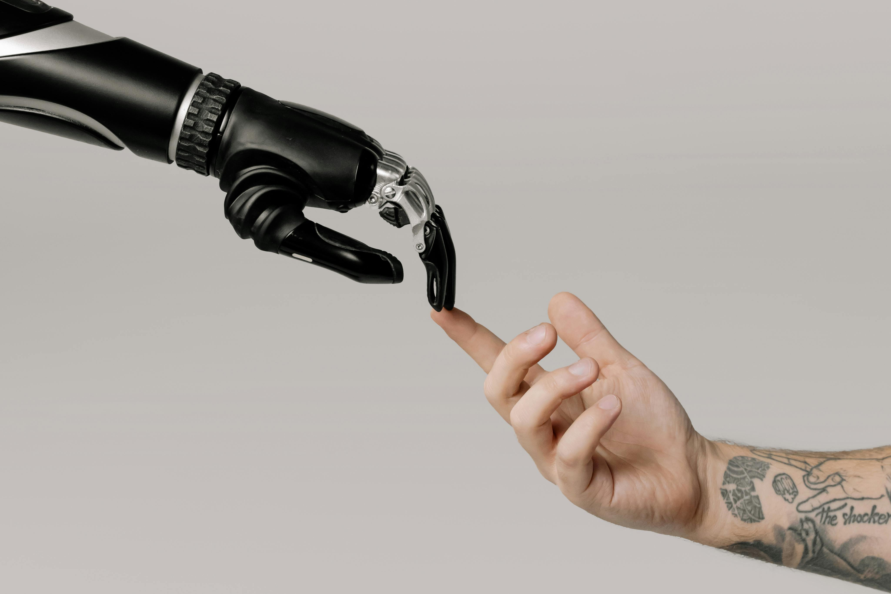









MCP - Flow
Human in the loop
Model
User
AI Application
-
MCP Host
MCP Client
MCP Server

Slide 21
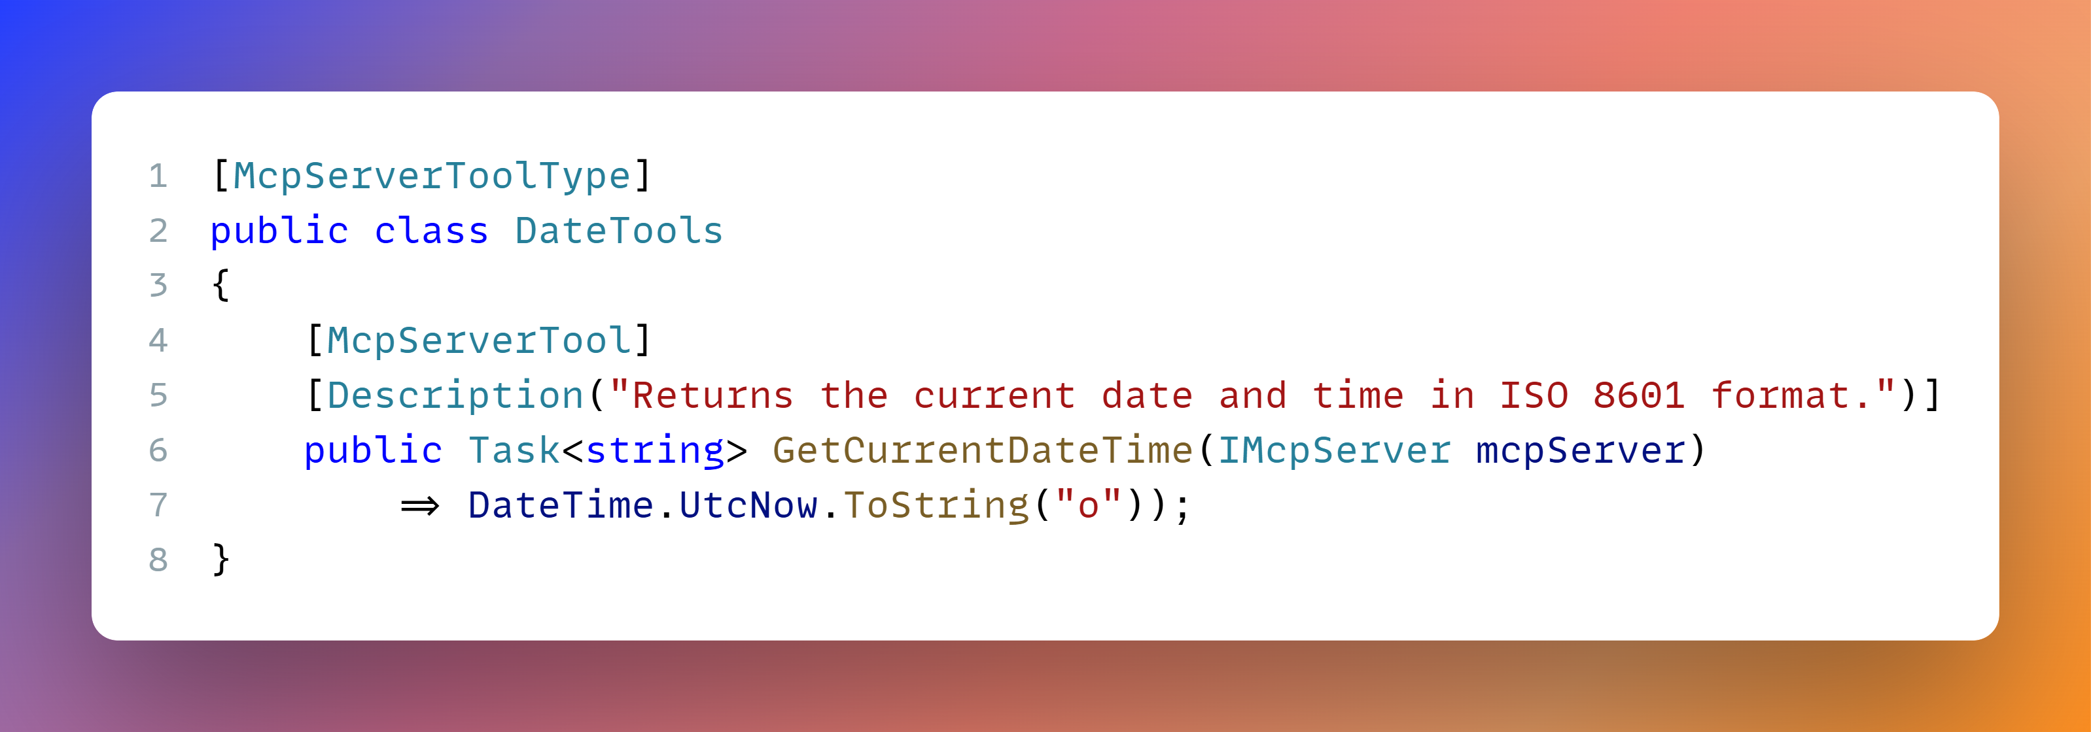
MCP Server - Tool
Notes:
[McpServerToolType]
public class DateTools
{
[McpServerTool]
[Description("Returns the current date and time in ISO 8601 format.")]
public Task<string> GetCurrentDateTime(IMcpServer mcpServer)
=> DateTime.UtcNow.ToString("o"));
}

Slide 22
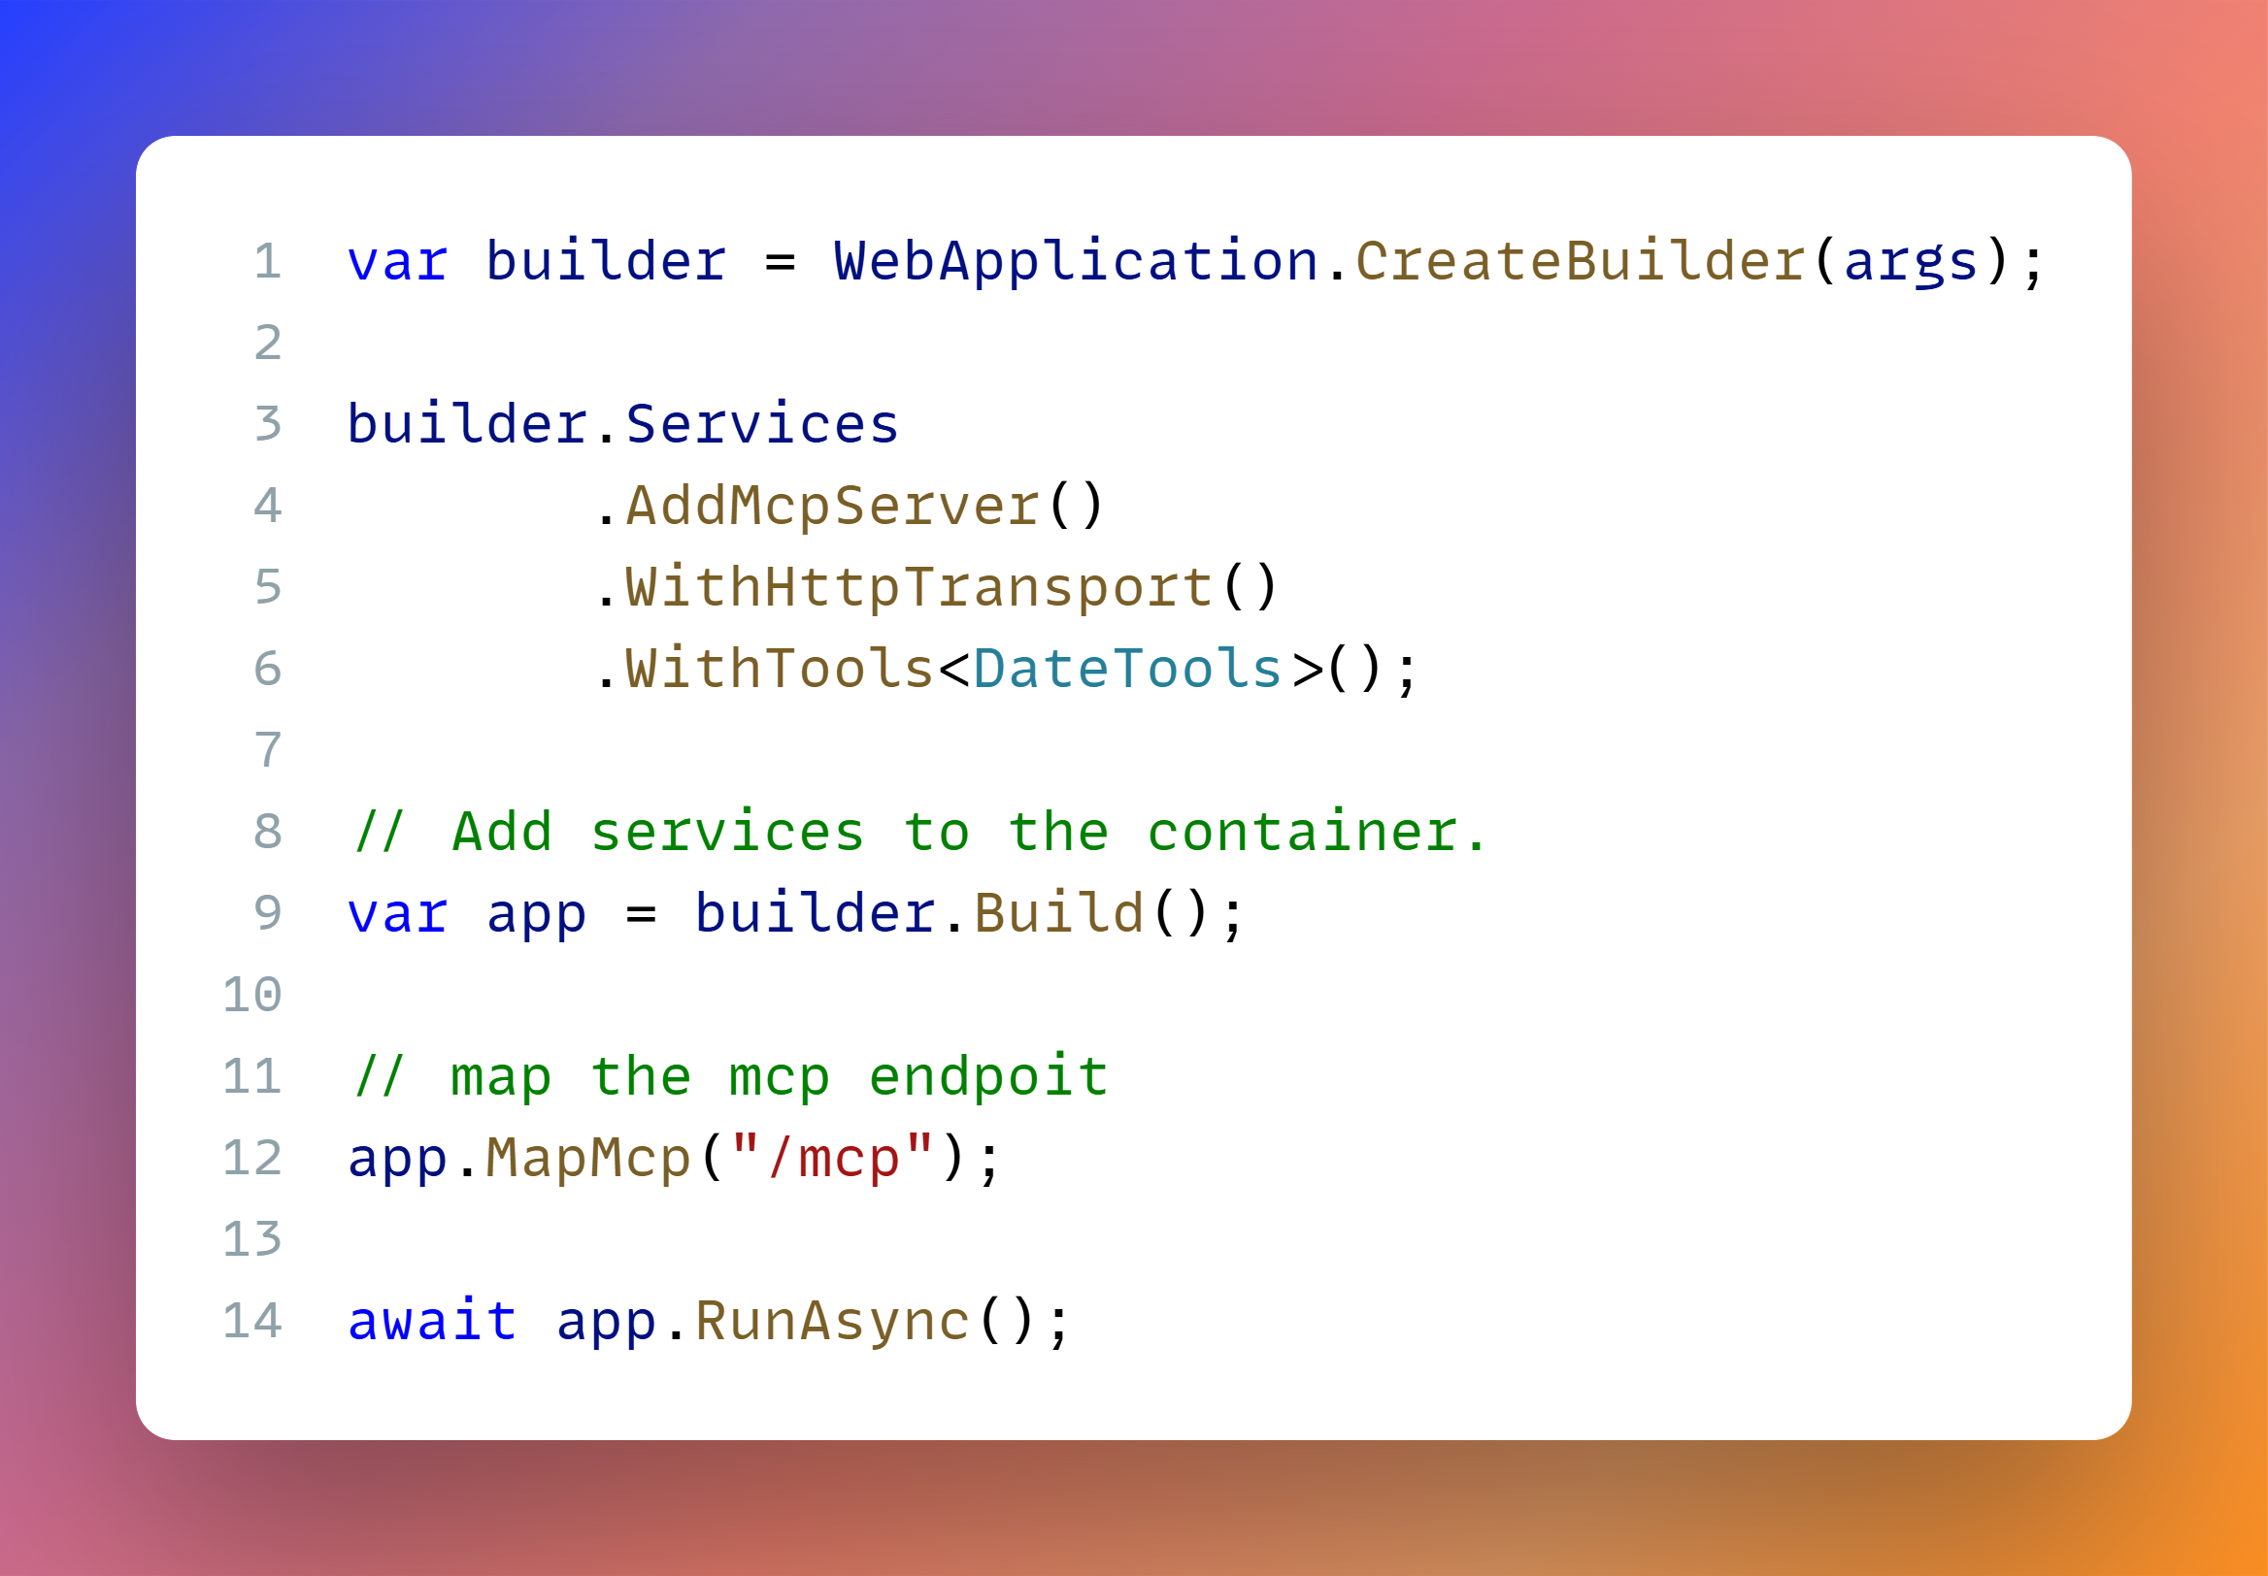
MCP Server
Notes:
var builder = WebApplication.CreateBuilder(args);
builder.Services
.AddMcpServer()
.WithHttpTransport()
.WithTools<DateTools>();
// Add services to the container.
var app = builder.Build();
// map the mcp endpoit
app.MapMcp("/mcp");
await app.RunAsync();

Slide 23
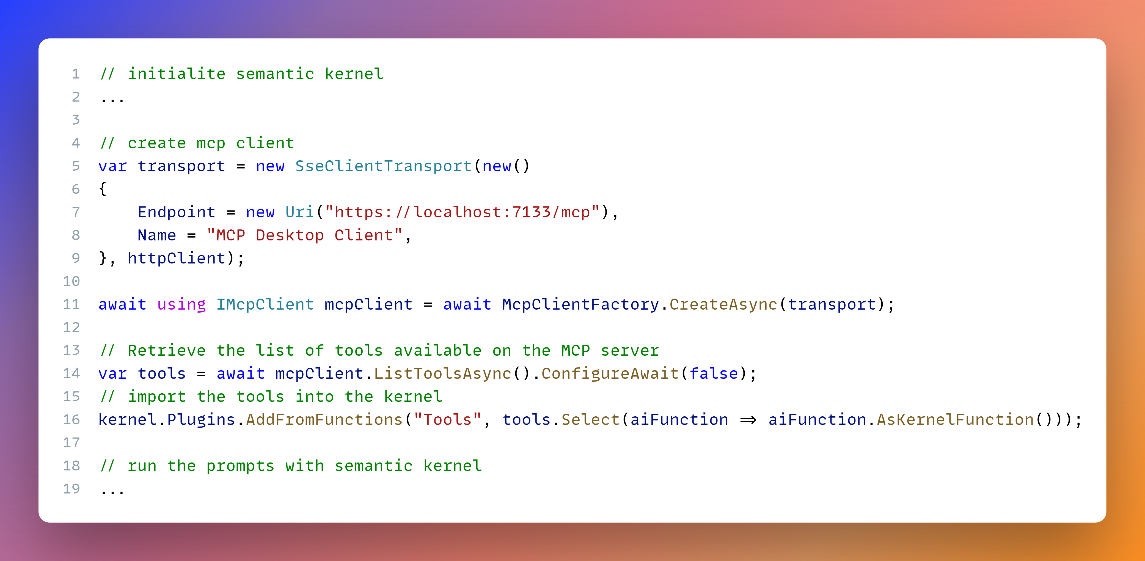
AI Agent & MCP Client

Slide 24
MCP - Elicitation
Model
User
AI Application
-
MCP Host
MCP Client
MCP Server

Slide 25
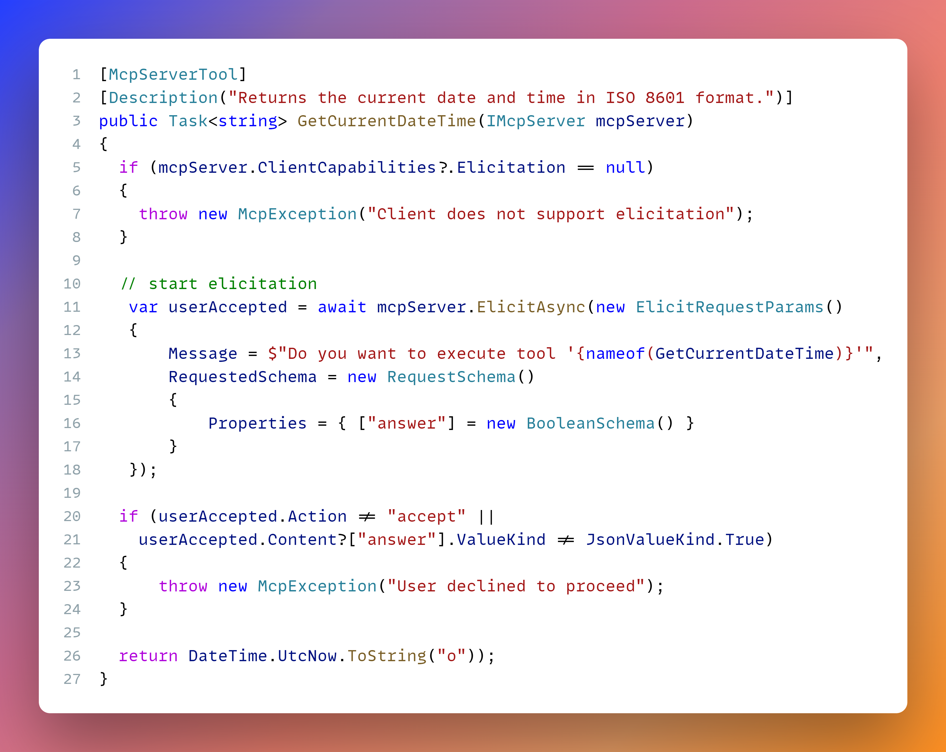
MCP Server – elicitation

Slide 26
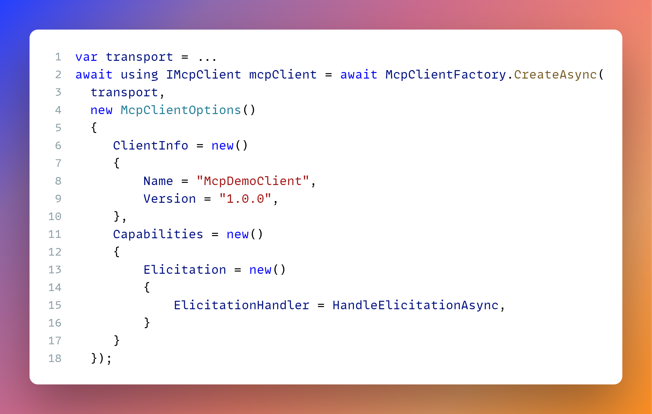
MCP Client – elicitation

Slide 27
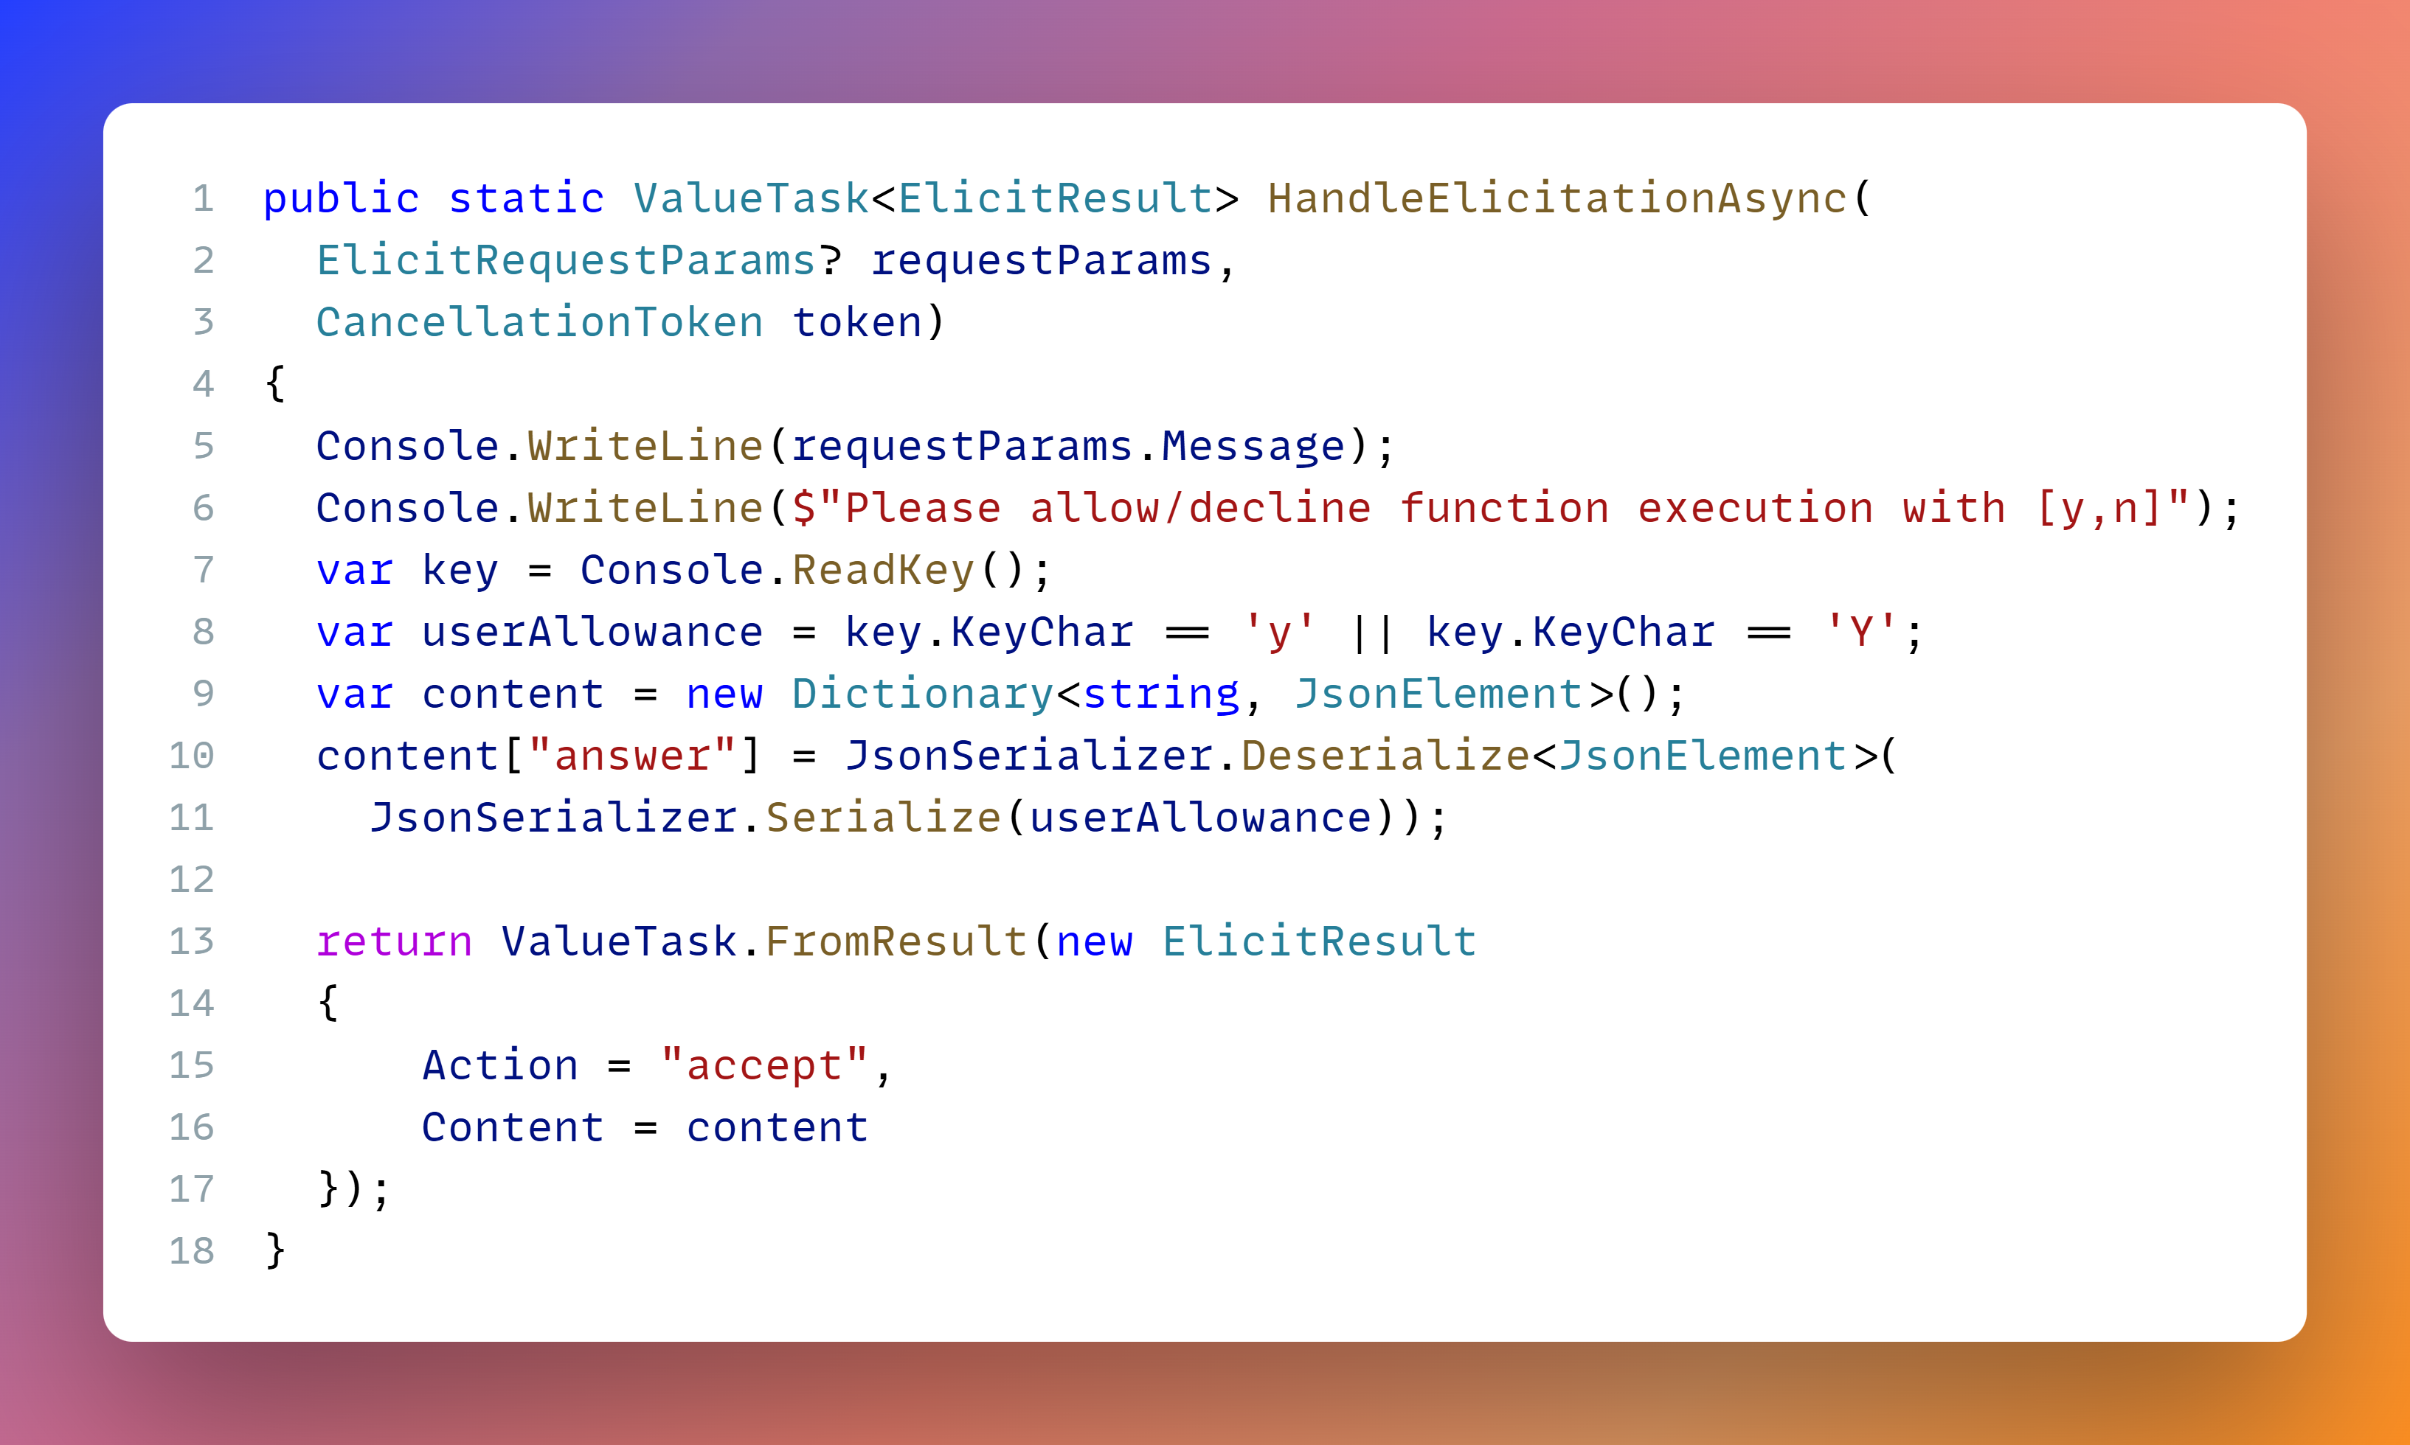
MCP Client – Elicitation handler

Slide 28
Secure MCP servers

Slide 29
Security best practices
Use OpenID Connect to acquire the access token
Use delegated user access tokens only
Follow a zero-trust strategy for applications
Don’t trust MCP servers, always validate the security first
Don't use public clients on the web

Slide 30
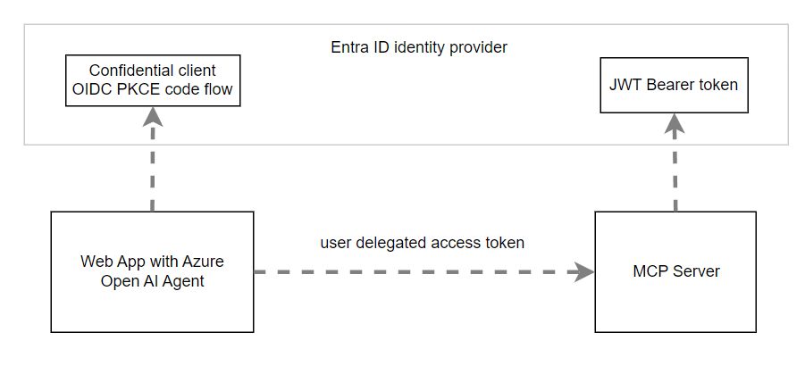
Security Setup

Slide 31
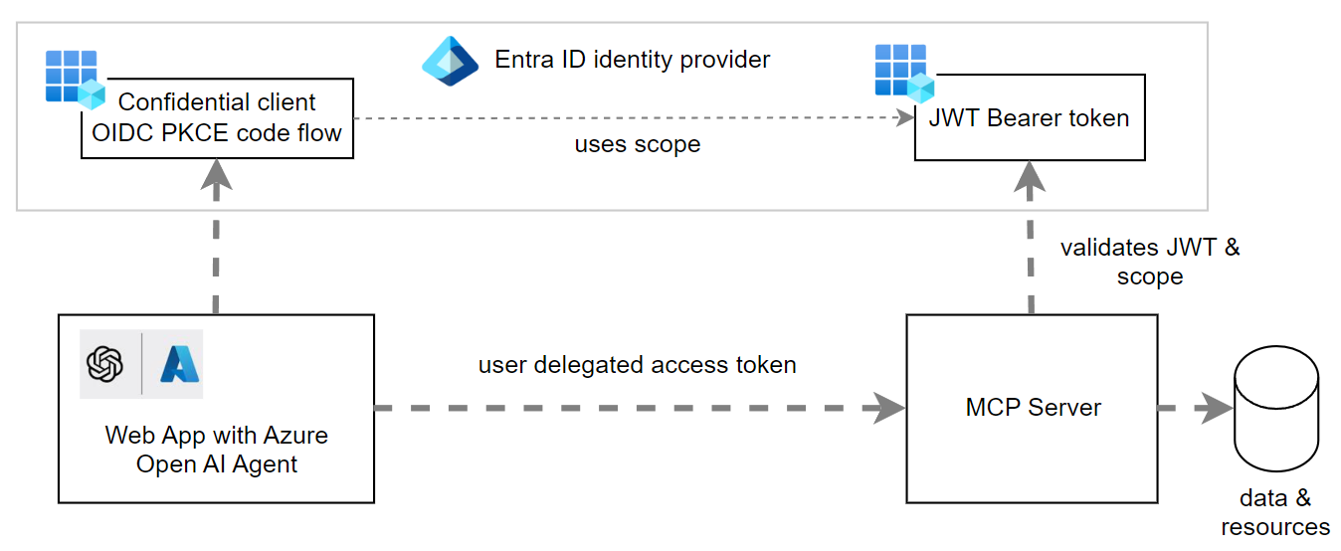
Microsoft Entra ID

Slide 32
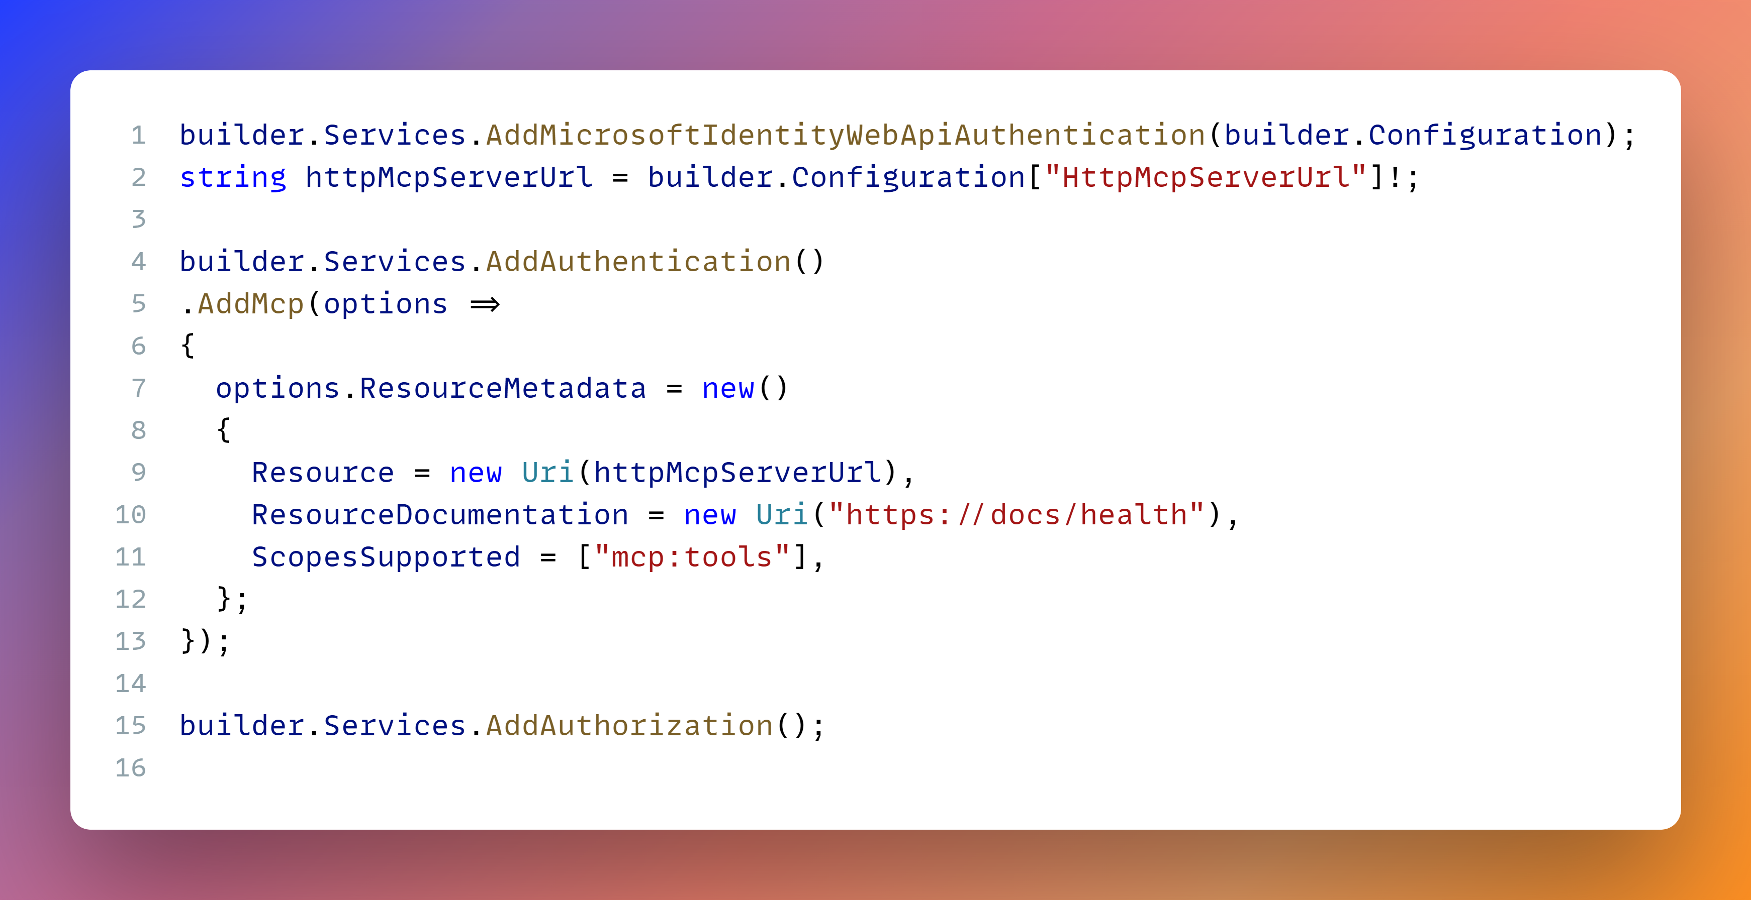
MCP Server OAuth security
Notes:
builder.Services.AddMicrosoftIdentityWebApiAuthentication(builder.Configuration);
string httpMcpServerUrl = builder.Configuration["HttpMcpServerUrl"]!;
builder.Services.AddAuthentication()
.AddMcp(options =>
{
options.ResourceMetadata = new()
{
Resource = new Uri(httpMcpServerUrl),
ResourceDocumentation = new Uri("https://docs/health"),
ScopesSupported = ["mcp:tools"],
};
});
builder. Services. AddAuthorization();

Slide 33
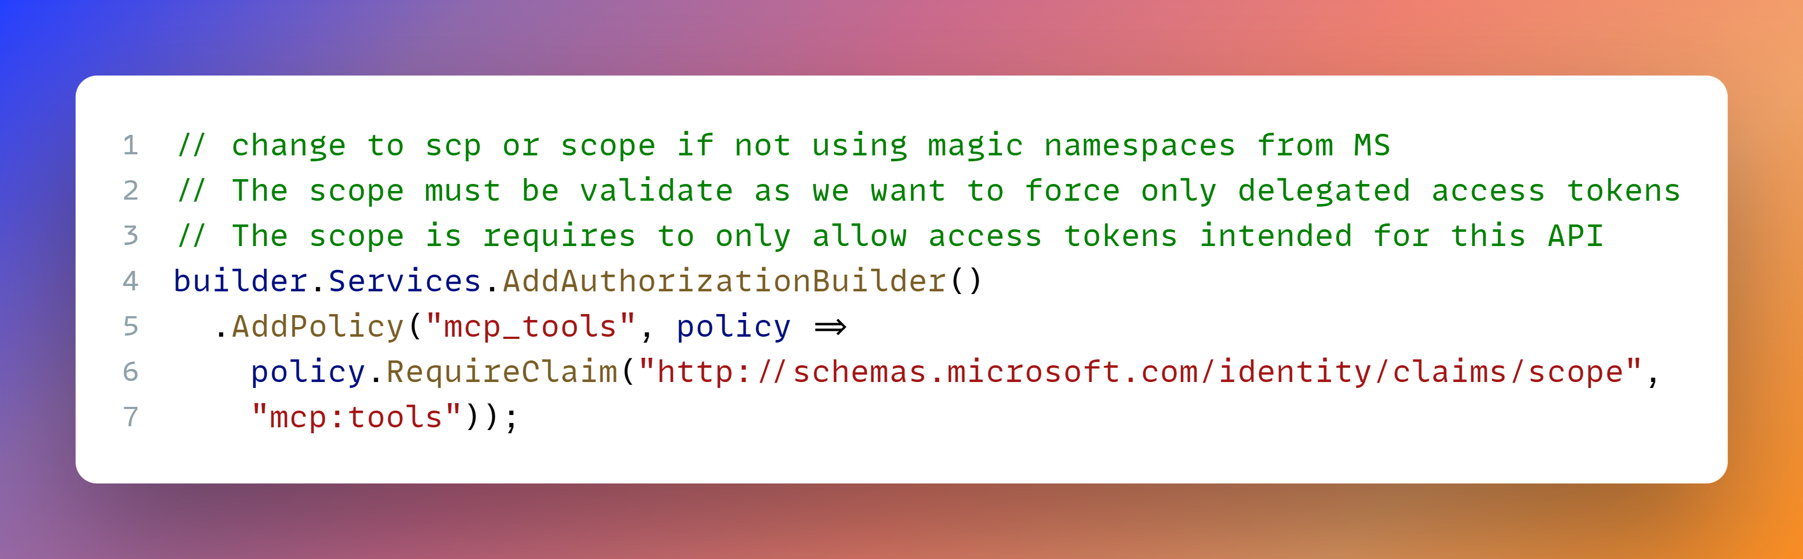
MCP Server OAuth security
Notes:
// change to scp or scope if not using magic namespaces from MS
// The scope must be validate as we want to force only delegated access tokens
// The scope is requires to only allow access tokens intended for this API
builder.Services.AddAuthorizationBuilder()
.AddPolicy("mcp_tools", policy =>
policy. RequireClaim("http://schemas.microsoft.com/identity/claims/scope",
"mcp:tools"));

Slide 34
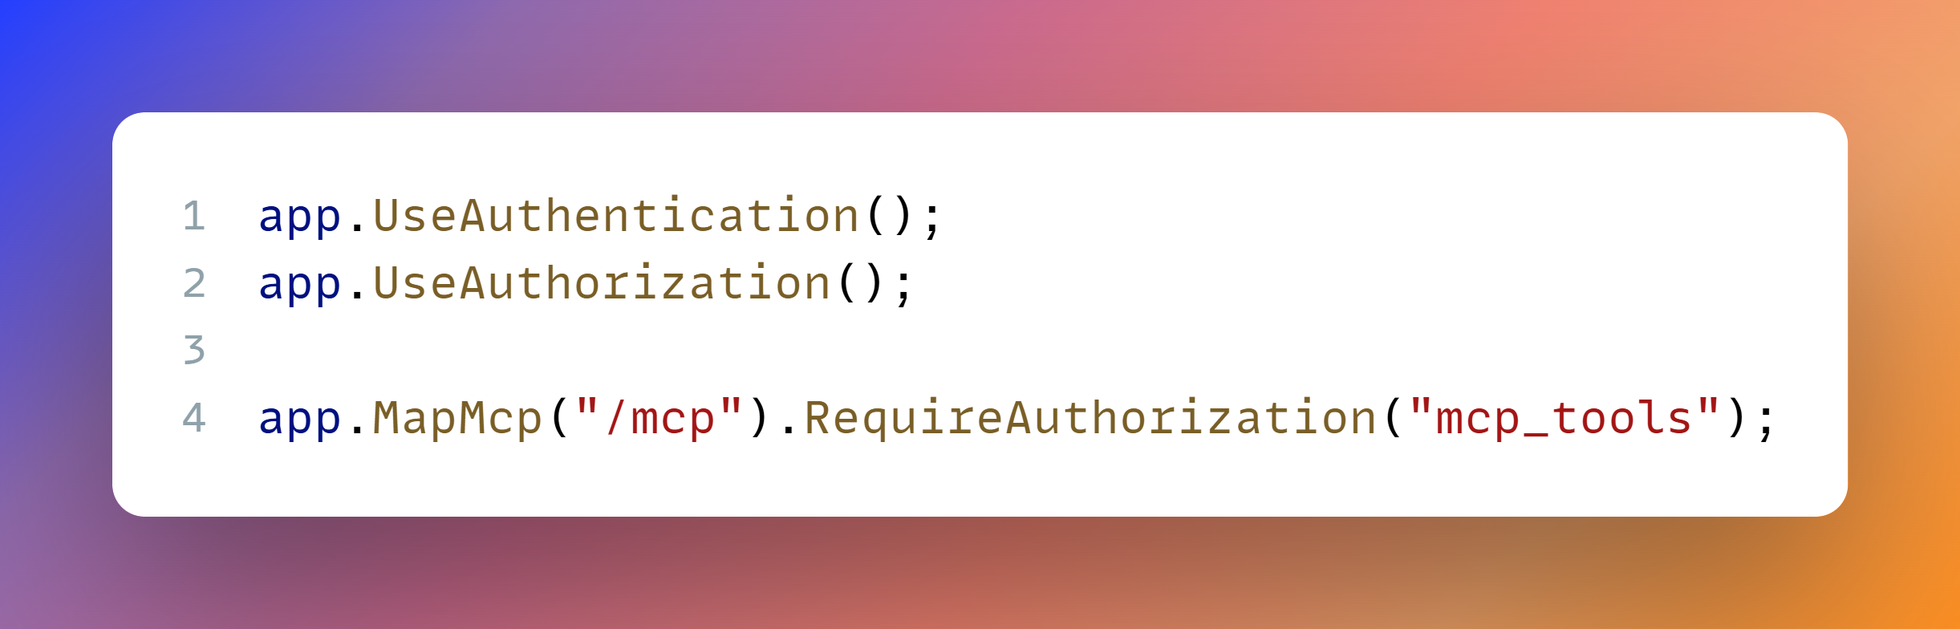
MCP Server OAuth security
Notes:
app.UseAuthentication();
app.UseAuthorization();
app.MapMcp("/mcp").RequireAuthorization("mcp_tools");

Slide 35
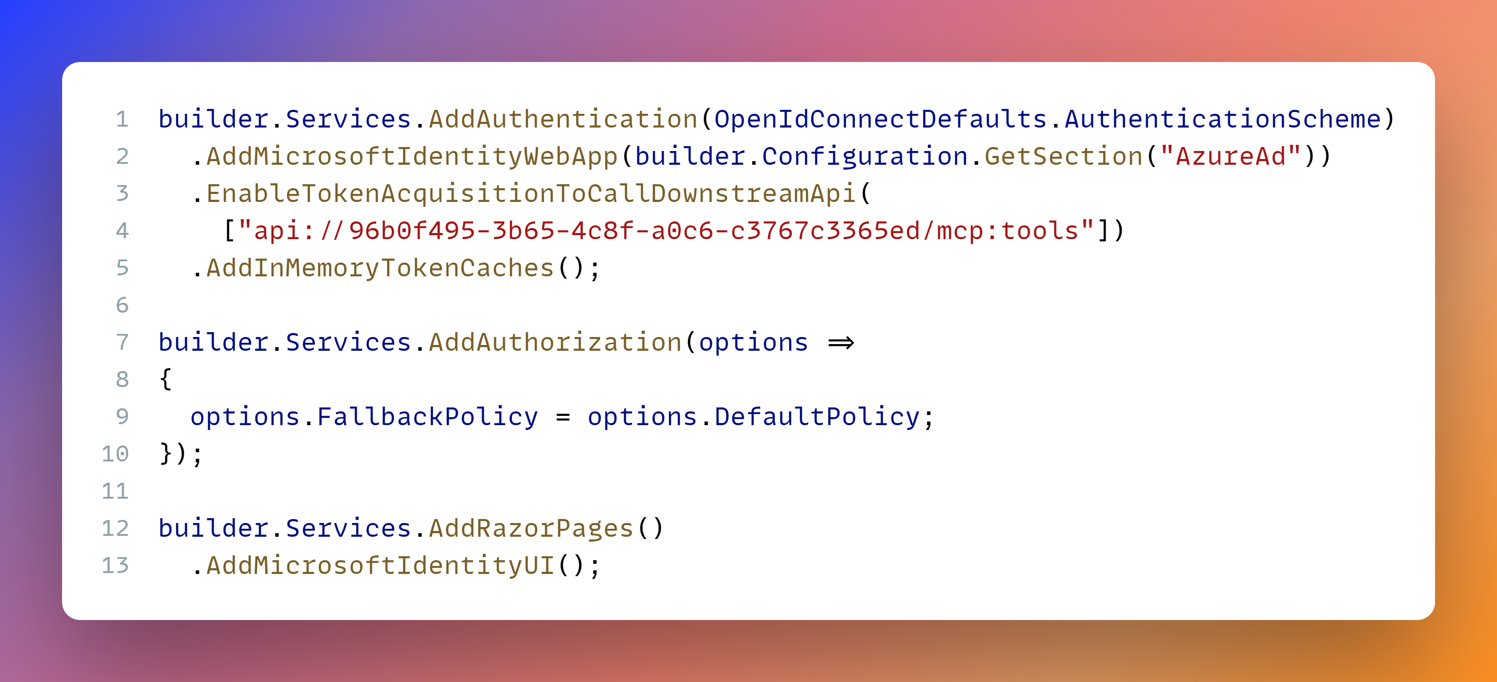
Confidential OIDC MCP Client
Notes:
builder.Services.AddAuthentication(OpenIdConnectDefaults.AuthenticationScheme)
.AddMicrosoftIdentityWebApp(builder.Configuration.GetSection("AzureAd"))
.EnableTokenAcquisitionToCallDownstreamApi(
["api://96b0f495-3b65-4c8f-a0c6-c3767c3365ed/mcp:tools"])
.AddInMemoryTokenCaches();
builder.Services.AddAuthorization(options =>
{
options.FallbackPolicy = options.DefaultPolicy;
});
builder.Services.AddRazorPages()
.AddMicrosoftIdentityUI();

Slide 36
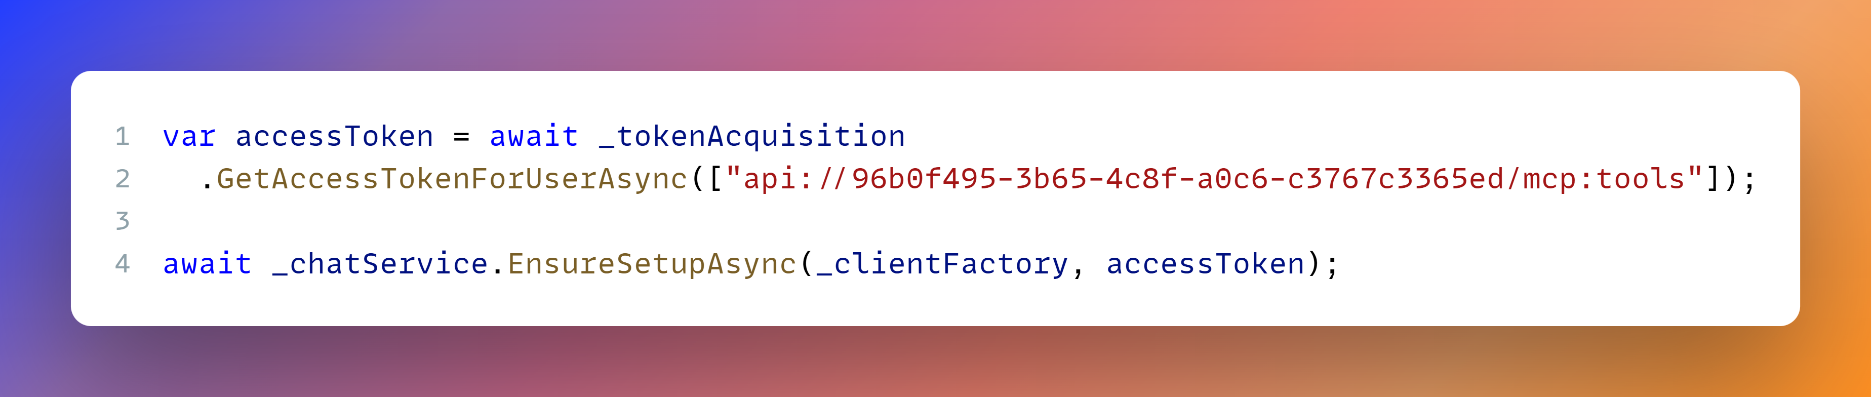
Confidential OIDC MCP Client
Notes:
var accessToken = await _tokenAcquisition
.GetAccessTokenForUserAsync(["api://96b0f495-3b65-4c8f-a0c6-c3767c3365ed/mcp:tools"]);
await _chatService.EnsureSetupAsync(_clientFactory, accessToken);

Slide 37
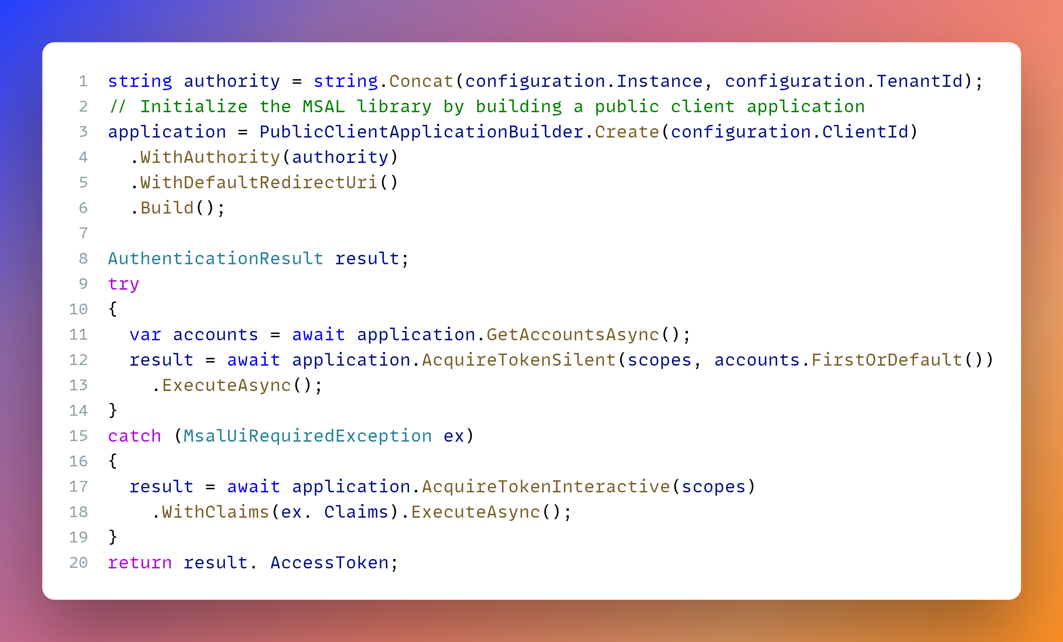
Public OIDC MCP Client
Notes:
string authority = string.Concat(configuration.Instance, configuration.TenantId);
// Initialize the MSAL library by building a public client application
application = PublicClientApplicationBuilder.Create(configuration.ClientId)
.WithAuthority(authority)
.WithDefaultRedirectUri()
.Build();
AuthenticationResult result;
try
{
var accounts = await application.GetAccountsAsync();
result = await application.AcquireTokenSilent(scopes, accounts.FirstOrDefault())
.ExecuteAsync();
}
catch (MsalUiRequiredException ex)
{
result = await application.AcquireTokenInteractive(scopes)
.WithClaims(ex. Claims).ExecuteAsync();
}
return result. AccessToken;

Slide 38
Model context protocol
MCP server architectures are very similar to Micro-services
architecture with all the same problems.

Slide 39
demo

Slide 40
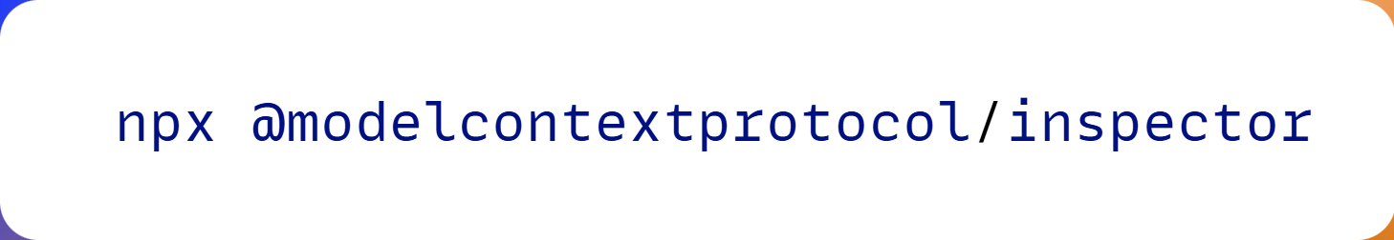
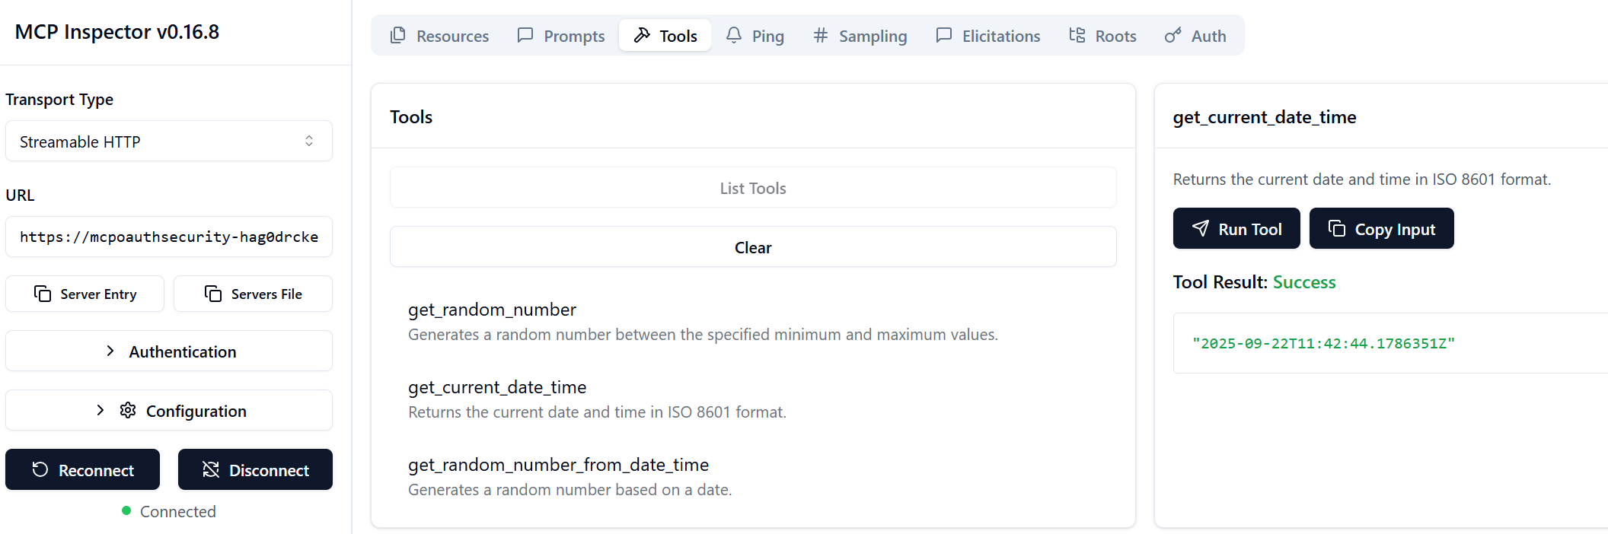
MCP Inspector

Slide 41
Demo
localhost
Azure

Slide 42
Recap & Recommendations

Slide 43
further security improvements
Use token binding with OAuth DPoP
Follow an immutable strategy, only append
Add audit logs for all changes
Keep a human in the loop
Don't allow App-to-App security for downstream APIs
Avoid A2A until security specs are finished

Slide 44

Recap
Star thinking about Business Use Case
Use advanced capabilities - Elicitation and Sampling
.NET MCP & Semantic Kernel
https://github.com/damienbod/McpSecurity
AI & Data Meetup @isolutions
13.11.2025
Security Meetup @isolutions
05.02.2026

Slide 45
References
MCP C# SDK
MCP Docs
MCP Inspector
MCP for beginners course

